Slide 1
10.009 Digital World
Week 3
Man, Geok See

Slide 2
Topics
Branching: if, elif, else
Repetitive task with loop (while-loop)
Compound data type: list

Slide 3
Branching: if, elif, else

Slide 4
Branching
Sometimes we want to perform different actions depending on a condition
Example:
sin x, 0 ≤ x ≤ pi
0, otherwise
{
f(x) =
from math import *
def f(x):
if 0<=x<=pi:
return sin(x)
else:
return 0

Slide 5
Branching
In general (the else block can be skipped):
if condition:
<block of statements, executed if condition is True>
else:
<block of statements, executed if condition is False>
Test for multiple conditions:
if condition1:
<block of statements> #execute if condition1 is True, then jump to <next statement>
elif condition2:
<block of statements> #execute if condition1 is False and condition2 is True
elif condition3:
<block of statements>
else:
<block of statements> #execute when all conditions are False
<next statement>

Slide 6
Branching
Important: only zero or one branch will be executed:
x = 10
if x > 0:
print ‘hello’
elif x > 0:
print ‘good bye’

Slide 7
Condition
Conditions are boolean expression normally
  Expressions that are evaluated to True or False
  Keywords: not, and, or
    not Cond changes from True to False and vice versa
    Cond1 and Cond2 is True if both are True
    Cond1 or Cond2 is True if at least one is True
All objects in Python can be evaluated in a boolean context
  All are True, except None, False, zero numbers, empty strings / lists / dictionaries
C == 40 # True if C equals 40
C != 40 # True if C does not equal 40
C >= 40 # C is greater than or equal to 40
C > 40 # C is greater than 40
C < 40 # C is less than 40

Slide 8
Condition
# what are the results of the following boolean expressions:
>>> x = 0; y = 1.2
>>> x >= 0 and y < 1
????
>>> x >= 0 or y < 1
????
>>> x > 0 or y > 1
????
>>> x > 0 or not y > 1
????
>>> -1 < x <= 0 # -1 < x and x <= 0
????
>>> not (x > 0 or y > 0)
????

Slide 9
Condition
# what are the results of the following boolean expressions:
>>> x = 0; y = 1.2
>>> x >= 0 and y < 1
False
>>> x >= 0 or y < 1
True
>>> x > 0 or y > 1
True
>>> x > 0 or not y > 1
False
>>> -1 < x <= 0 # -1 < x and x <= 0
True
>>> not (x > 0 or y > 0)
False

Slide 10
While loops
Example: Suppose we need to print out a conversion table with Celsius degrees in the first column and corresponding Fahrenheit degrees in the second column:
10 50.0
11 51.8
12 53.6
13 55.4
14 57.2
15 59.0
#solution 1: repeat the statements
c=10; f = 9.0/5 * c + 32; print c, f
c=11; f = 9.0/5 * c + 32; print c, f
c=12; f = 9.0/5 * c + 32; print c, f
c=13; f = 9.0/5 * c + 32; print c, f
c=14; f = 9.0/5 * c + 32; print c, f
c=15; f = 9.0/5 * c + 32; print c, f

Slide 11
While loops
Better solution: with loop (while loop)
The while loop repeats a set of statements as long as a condition is True
  When the condition is True, the program enters the loop and executes all indented statements
  Until the condition is no longer True, the loop terminates, the program proceeds to the next statement that has the same indentation as the while statement
What happens if we remove the last statement c=c+1?
c = 10
while c<=15:
f = 9.0/5 * c + 32
print c,f
c = c+1

Slide 12
Data type: List
Up to now, a variable has typically contained a single number
Sometimes, some numbers are naturally grouped together
  All the Celsius temperatures in the previous example
Python list can be used to represent such a group of numbers
  Can work with the whole group at once
  Can also access individual elements of the group

Slide 13
Data type: List
Every element is associated with an index, which reflects the position in the list
  First element has index 0, second index 1, and so on
>>> c = [10, 11, 12, 13, 14, 15]
>>> c[0]
10
>>> c[1]
11
>>> c[5]
15
>>> c[6]
Traceback (most recent call last):
File "<pyshell#68>", line 1, in <module>
c[6]
IndexError: list index out of range
>>> c[-1]
15
>>> sum(c)
75
>>> min(c)
10
>>> len(c)
6

Slide 14
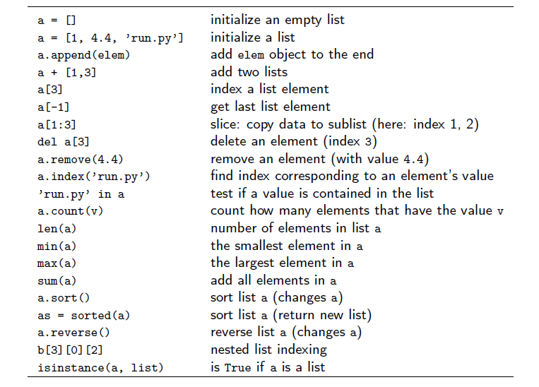
Basic List Operation

Slide 15
Create a list in a loop
To produce a list: 1², 2², 3², 4², … 10²
#create a list
count = 1
resultList = []
while count <= 10:
resultList.append( count **2 )
count = count + 1
print resultList

Slide 16
Traverse a list (with while loop): walk through all list elements
Example: write a function printList, given an integer list as input, print out each element nicely in this format “index : element”
>>>
>>> c=[10,11,12,13,14,15]
>>> printList(c)
0 : 10
1 : 11
2 : 12
3 : 13
4 : 14
5 : 15

Slide 17
Traverse a list (with while loop)
def printList(a):
length = len(a)
index = 0
while index < length:
print '%d : %d' % (index, a[index])
index = index + 1
Modify this to compute the sum of the list (cohort problem)

